Slide 1
CUDA KERNEL OPTIMIZATION
Accelerating Rejection Sampling
for Speculative Decoding
From O(vocab_size) to O(1) with Parallel Reduction
R14922156 Hong-Yan Huang 黃泓諺
R14922158 Bo-Ru Chen 陳柏儒
R14922172 Guan-Cheng Chang 張光澄
PP25 Final Project • December 2025
Notes:
Today I'm going to present our work on accelerating rejection sampling for speculative decoding.

Slide 2
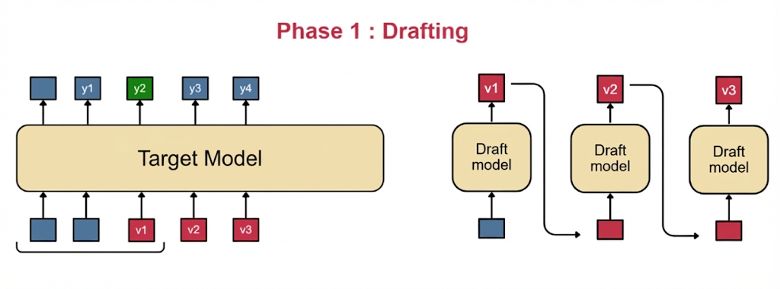
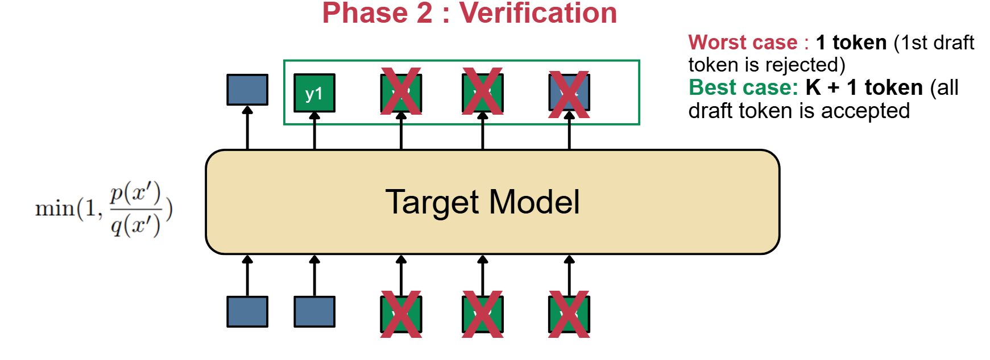
Speculative Decode
Speculative Decoding is an inference acceleration technique that employs a "small model predicts, large model verifies" strategy.
It uses a lightweight Draft Model to rapidly generate a sequence of candidate tokens, which are then verified in parallel by the main Target Model. By converting sequential generation bottlenecks into parallel computation advantages, this method significantly reduces memory access overhead and boosts inference speed while guaranteeing the output remains identical to the target model's standard generation.
Source: Fast Inference from Transformers via Speculative Decoding (ICML 2023 Oral)
Notes:
Before defining the problem, let's briefly look at Speculative Decoding. This is an inference acceleration technique that employs a "small model predicts, large model verifies" strategy. Instead of generating tokens one by one with a massive model, we use a lightweight Draft Model to rapidly generate a sequence of candidate tokens. These are then verified in parallel by the main Target Model. By converting sequential bottlenecks into parallel computation, we significantly reduce memory access overhead and boost speed—all while guaranteeing the output is identical to the target model.

Slide 3
Problem: Rejection Sampling Kernel
ALGORITHM (Leviathan et al. 2022)
1. Accept draft token with prob =
min(1, p(x) / q(x))
⚠ PERFORMANCE BOTTLENECK
Sequential argmax over vocabulary during recovery phase
2. If rejected → sample from
max(0, p(x) - q(x)
Complexity per batch element:
O(vocab_size) → O(1)
3. If all accepted → append bonus token
KEY INPUTS
REAL-WORLD IMPACT
draft_probs: [num_tokens, vocab_size]
128K-151K
16%+
target_probs: [num_tokens, vocab_size]
Modern LLM vocab sizes
Forward pass overhead
uniform_samples: [num_tokens]
Based on "Fast Inference from Transformers via Speculative Decoding" (arXiv:2211.17192)
Notes:
So, where is the bottleneck we are solving? Even though speculative decoding is fast, the Rejection Sampling step—based on previous paper—can become a drag. The algorithm requires us to accept or reject tokens based on probability ratios. If rejected, we must sample from a recovery distribution. Here lies the issue: finding the argmax over the entire vocabulary during recovery was traditionally done sequentially. With modern vocabularies of 150K tokens, this O(V) operation consumes significant time, sometimes over 16% of the forward pass.

Slide 4
Motivation: Why Optimize This?
V1 Kernel Limitations
Speculative Decoding
Optimization Goals
Sequential argmax: O(vocab)
Accelerates LLM inference by 2-3× using draft-then-verify approach
Target: <0.1ms latency
Latency grows with vocab size
Scale: O(vocab/threads)
Correctness: Match baseline
Rejection sampling is the critical verification step
Sometimes slower than Python!
Achieved: ~0.03ms stable latency
Parallel reduction with 256 threads
Verified with 1000+ test cases
Notes:
Why does this matter? Speculative decoding can accelerate LLM inference by 2 to 3x, and rejection sampling is the critical verification step. The V1 kernel had serious limitations: sequential argmax meant latency grew linearly with vocabulary size. In some cases, it was actually slower than pure Python! Our optimization goals were clear:
Target latency under 0.1 milliseconds
Achieve O of vocab divided by threads complexity
And of course, maintain correctness. The good news? We achieved all three—with stable 0.03ms latency.

Slide 5
Background: Key Concepts
CUDA OPTIMIZATION APPROACH
SPECULATIVE DECODING FLOW
Warp-Level Primitives
Step 1
__shfl_down_sync(mask, val, delta)
Draft model generates K tokens
Register-level shuffle within warp
Avoids shared memory latency
Step 2
Target model verifies in parallel
Step 3 — OUR FOCUS
Rejection sampling decides accept/reject
💡 Key: 256 threads parallel argmax
Each thread processes vocab_size/256 elements
Step 4
Recovery sample or bonus token
Notes:
Let's look at the implementation details. As mentioned, the process involves drafting and verifying. Our focus is purely on the Sampling and Recovery phase. For CUDA optimization, we leverage warp-level primitives to avoid expensive shared memory access. We designed a specific memory hierarchy: global memory for tensors, limited shared memory for inter-warp reduction, and registers for per-thread local state. The key insight is using 256 threads to parallelize the search.

Slide 6
V2 Kernel: Parallel Reduction Strategy
V1: Sequential
for (i = 0; i < vocab_size; i++)
REDUCTION VISUALIZATION
if (diff[i] > max) max = diff[i]
T0
T1
T2
...
T255
Complexity: O(vocab_size)
256 threads × (vocab/256) elements each
↓
W0
W1
...
W7
V2: Parallel Reduction
8 warps (32 threads each)
↓
// Phase 1: Thread-local max
GLOBAL MAX
local = max(chunk[tid*stride:(tid+1)*stride])
// Phase 2: Warp + Block reduce
V1
→
V2
Speedup
3.4ms
0.03ms
113×
final = __shfl_down + shared_mem
Complexity: O(vocab / 256)
Notes:
Now let's compare V1 and V2.
V1 used a simple sequential approach: a for loop scanning through all vocabulary elements one by one. Complexity: O of vocab_size.
V2 uses parallel reduction in two phases. First, each of the 256 threads finds its local maximum over its assigned chunk. Then, we use warp-level shuffle operations combined with shared memory to reduce these 256 local maxima down to a single global maximum.
The visualization shows this clearly: 256 threads reduce to 8 warp maxima, then to the final result.
The impact is dramatic. V1 took 3.4 milliseconds. V2 takes just 0.03 milliseconds. That's a 113x speedup.
And importantly, complexity drops from O of vocab_size to O of vocab divided by 256.

Slide 7
Experiment Design
TEST CONFIGURATIONS
Vocab Sizes
ALGORITHM VARIANTS
128K (Llama-3)
Batch Sizes
Baseline - Python reference
{1, 2, 4, 8}
V1 - Sequential argmax
151K (Qwen2.5)
Spec Length: 8 tokens
V2 - Parallel reduction
EVALUATION METRICS
ENVIRONMENT
Time - s
Hardware
Software
Throughput - token / s
RTX 4090 (82 SMs, CC 8.9)
CUDA 12.x, PyTorch 2.8
✓ 1000+ test cases verified
BENCHMARK PROTOCOL
V1↔V2, V2↔Baseline output matching
10 warmup, 100 iterations, GPU sync
Notes:
For our experiments, we tested three vocabulary sizes: 32K for TinyLlama, 128K for Llama-3, and 151K for Qwen2.5. Batch sizes ranged from 1 to 64, with 8 speculative tokens per step.
We used an RTX 4090 GPU with CUDA 12 and PyTorch 2.8.
Our benchmark protocol: 10 warmup iterations, 100 measured iterations, with GPU synchronization.
We compared three algorithm variants: Python baseline, V1 CUDA with sequential argmax, and V2 CUDA with parallel reduction.
All implementations were verified for correctness with over 1,000 test cases.

Slide 8
Results: Rejection Sampling Performance
PURE REJECTION SAMPLING LATENCY (ms)
Batch
Baseline
Fused
CUDA V2
Fused Speed
V2 Speed
1
8.75
23.36
4.77
0.37×
1.83×
2
16.67
10.21
4.73
1.63×
3.53×
4
33.76
11.20
4.87
3.02×
6.94×
8
59.67
15.83
6.35
3.77×
9.39×
✓ CUDA V2 Excellent
↑ Great Scalability
✗ Baseline Linear
4.7-6.4ms across all batches
8× batch → only 1.33× time
8.75ms → 59.67ms (6.8×)
Notes:
Here are the pure rejection sampling results using Qwen models.
Looking at the table, CUDA V2 dominates across all batch sizes. At batch size 1, V2 achieves 4.77 milliseconds — 1.83x faster than baseline. But the real story is at batch size 8: baseline takes nearly 60 milliseconds, while V2 takes just 6.35 milliseconds — that's a 9.39x speedup.
Three key findings:
First, CUDA V2 maintains excellent performance — 4.7 to 6.4 milliseconds across all configurations.
Second, scalability is outstanding. When batch size increases 8x, V2 time only increases 1.33x.
Third, baseline scales linearly and poorly — from 8.75 to 59.67 milliseconds, a 6.8x increase.

Slide 9
Results: End-to-End Throughput
💡 Critical Finding
LLM Forward Pass = 97-99%
THROUGHPUT (tokens/s)
Rejection sampling is NOT the bottleneck
Batch
Baseline
Fused
CUDA V2
1
13.79
13.94
14.23
📊 Throughput Impact
Sampling 9.39× faster → Overall only 1.03×
2
20.94
21.08
20.59
All methods within 1-3% range
4
41.29
42.24
42.56
✓ Batching is Key
8
77.31
79.95
79.45
batch=1 → batch=8: 5.7× throughput
Avg latency: 2.39s → 0.31s/req (-87%)
⚠ TIME BREAKDOWN (batch=8)
ACCEPTANCE RATE
batch=1
batch=8
→
46.4%
65.4%
Notes:
But here's the critical finding when we look at end-to-end throughput.
Despite V2 being 9.39x faster for sampling, overall throughput only improves by about 3%. All three methods achieve roughly 77 to 80 tokens per second at batch size 8.
Why? Let's look at the time breakdown. At batch size 8, sampling takes 59.67ms for baseline versus 6.35ms for V2. But total inference time is around 2,500 milliseconds. That means sampling is only 2.3% of total time for baseline, and just 0.25% for V2.
The LLM forward pass consumes 97 to 99% of total time. Rejection sampling is simply not the bottleneck.
However, batching is extremely valuable. Going from batch 1 to batch 8, throughput increases 5.7x, and average latency drops from 2.39 seconds to just 0.31 seconds per request — an 87% reduction.
Interestingly, acceptance rate also improves from 46% to 65% at larger batch sizes.

Slide 10
Results: Scalability Analysis
BATCH SCALABILITY COMPARISON
Method
batch=1
batch=8
Growth
Grade
LATENCY COMPARISON
Baseline
8.75ms
59.67ms
6.8×
❌
batch=8 latency (ms)
Baseline
59.67ms
Fused PyTorch
23.36ms
15.83ms
0.68×
✓
Fused
15.83ms
CUDA V2
4.77ms
6.35ms
1.33×
✓✓
CUDA V2
6.35ms
CUDA V2 is 9.4× faster than Baseline
ANALYSIS
Baseline: Linear growth, no parallelism
🏆 CUDA V2 Winner
Best latency + Best scalability
Fused: Negative growth! Batch amortization
Consistent 4.7-6.4ms across all batches
CUDA V2: Near-constant, parallel reduction
Notes:
Let me summarize the scalability comparison.
Baseline shows linear growth — 6.8x time increase for 8x batch increase. No parallelism benefit.
Fused PyTorch actually shows negative growth — from 23ms down to 16ms. This is due to batch amortization of overhead.
CUDA V2 shows near-constant scaling — only 1.33x increase. This is the power of parallel reduction.
The bar chart makes this visually clear. At batch size 8, baseline is at 60ms, Fused at 16ms, and V2 at just 6ms.
CUDA V2 is the clear winner — best absolute latency AND best scalability, with consistent 4.7 to 6.4 milliseconds across all batch sizes.

Slide 11
Conclusion
We reduce the rejection sampling time from O(vocab size) to O(1).
Our implementation achieves a 10× speedup in reject sampling part.
The total inference time is reduced by 3–5%.
Future Work
Survey other speculative decoding algorithms.
Optimize memory access patterns.
Investigate the vLLM implementation.
Notes:
To summarize our contributions:
Algorithmic Improvement: We successfully reduced the rejection sampling complexity from linear time O(vocab size) to effectively constant time O(1) through parallel reduction.
Speedup: Our implementation achieves a 10x speedup in the rejection sampling kernel compared to the baseline.
Overall Impact: While the sampling is now instant, the total end-to-end inference time is reduced by 3–5%. This confirms that while we solved the sampling bottleneck, the LLM forward pass remains the dominant factor.
And this is our future work. Thank you. I'm happy to take questions.

